Slide 1
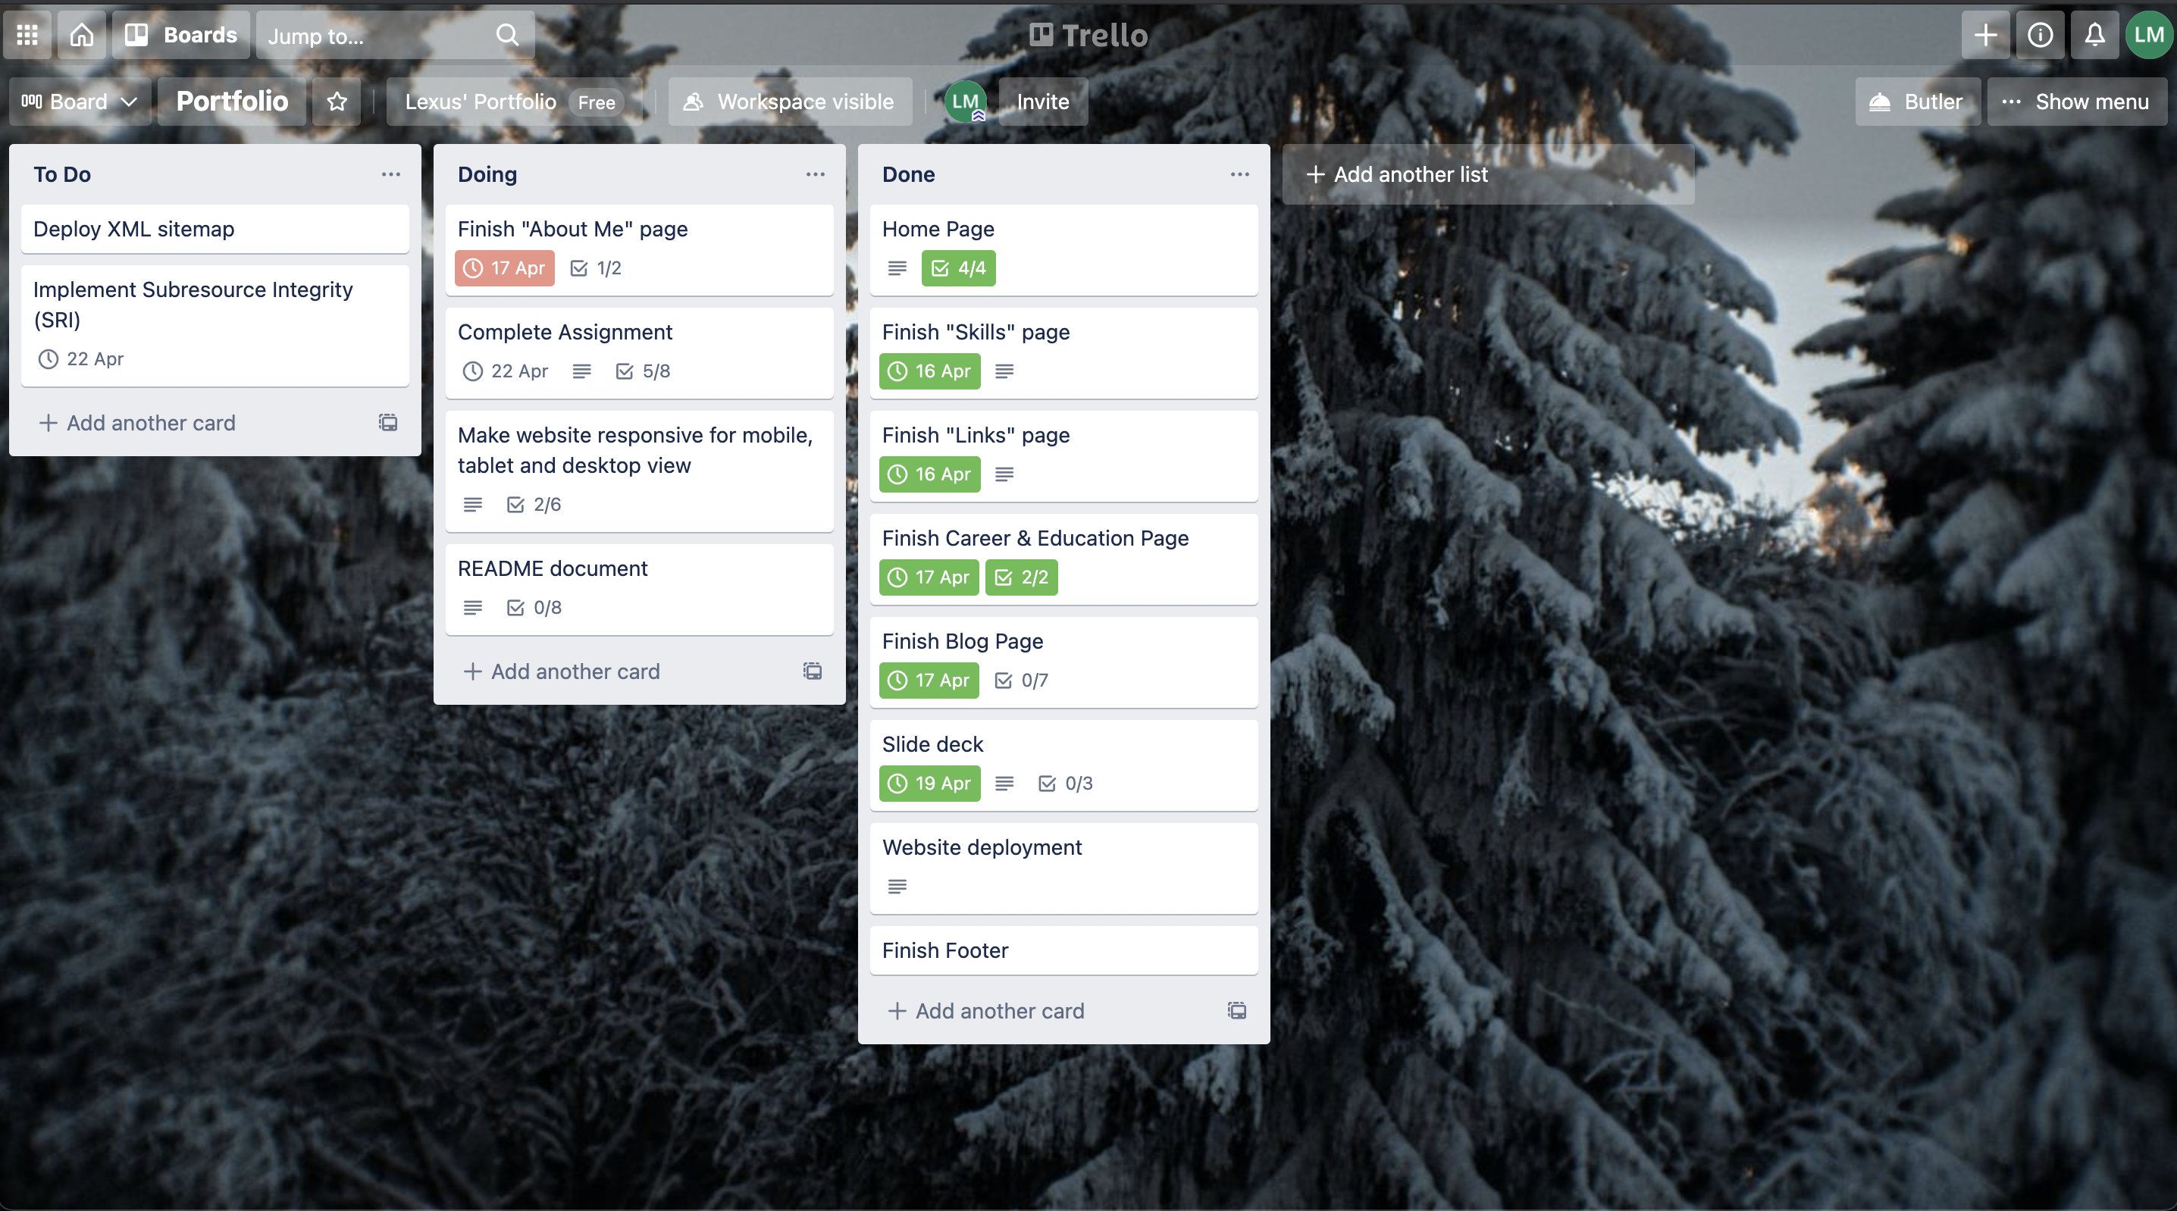
Keeping Track of Progress

Slide 2

Design Process
Sitemaps
Colour Palette
Wireframes

Slide 3
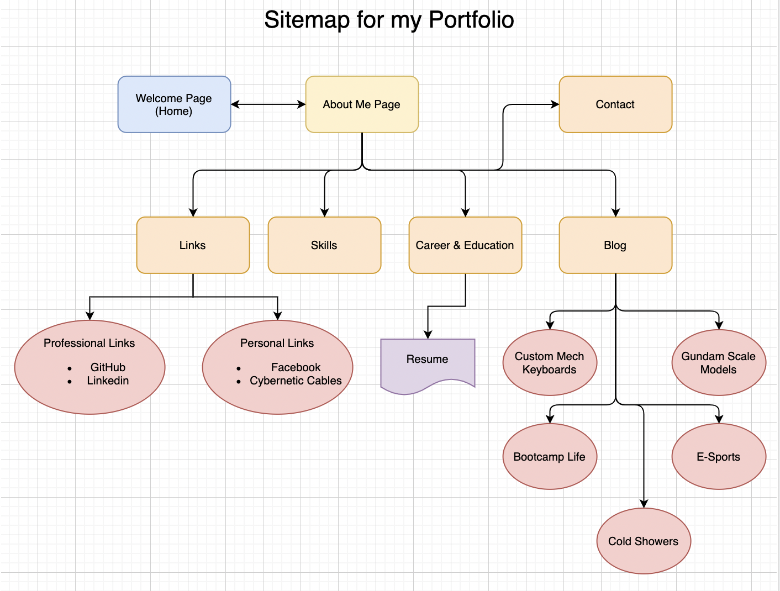
Sitemap

Slide 4
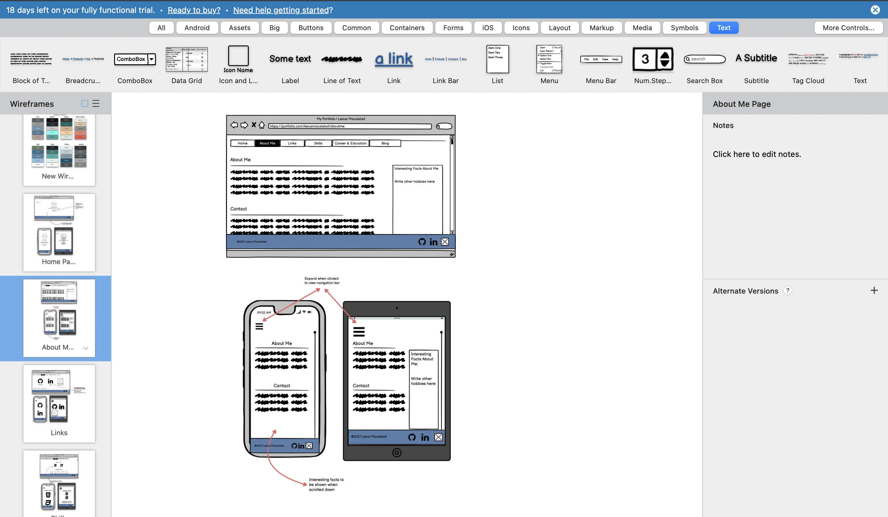
Wireframes

Slide 5
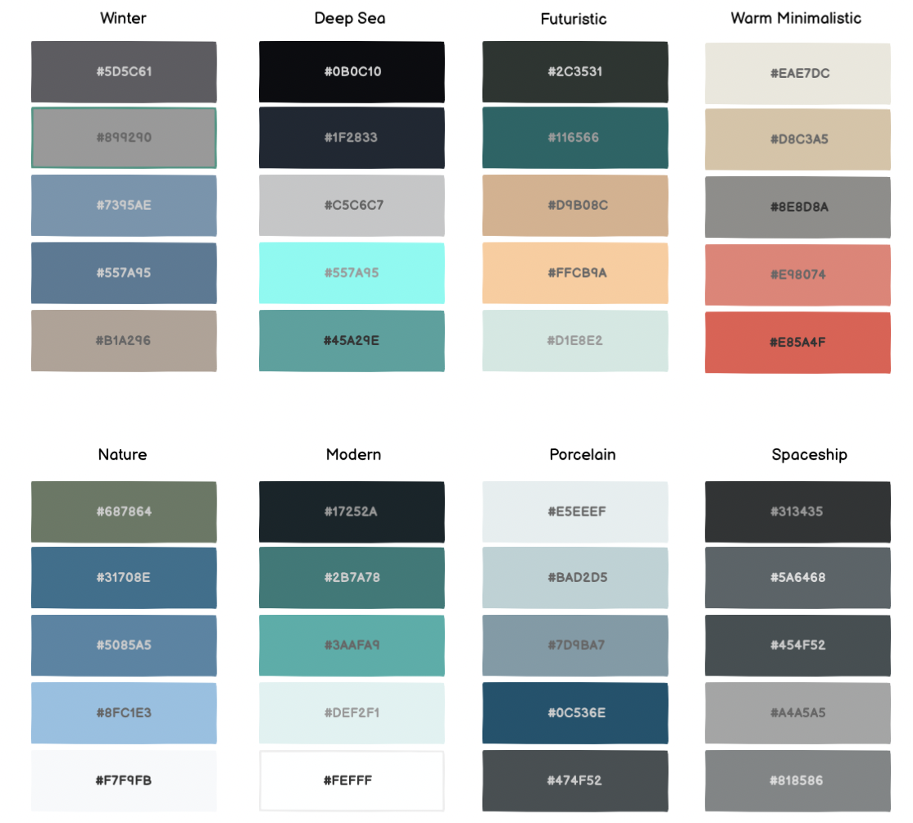
Colour Palettes

Slide 6
Components Used
Navigation bar
Elements with animations to keep the audience engaged
Minimal colours

Slide 7
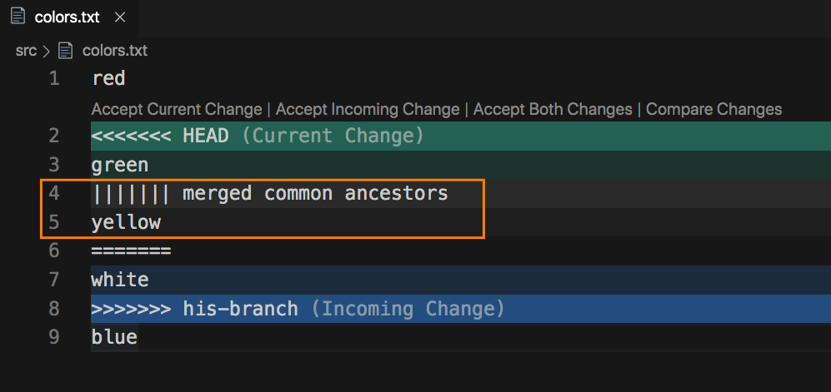
Challenges/Roadblocks
Git Conflicts
Element positioning
Margin
Flexbox

Slide 8
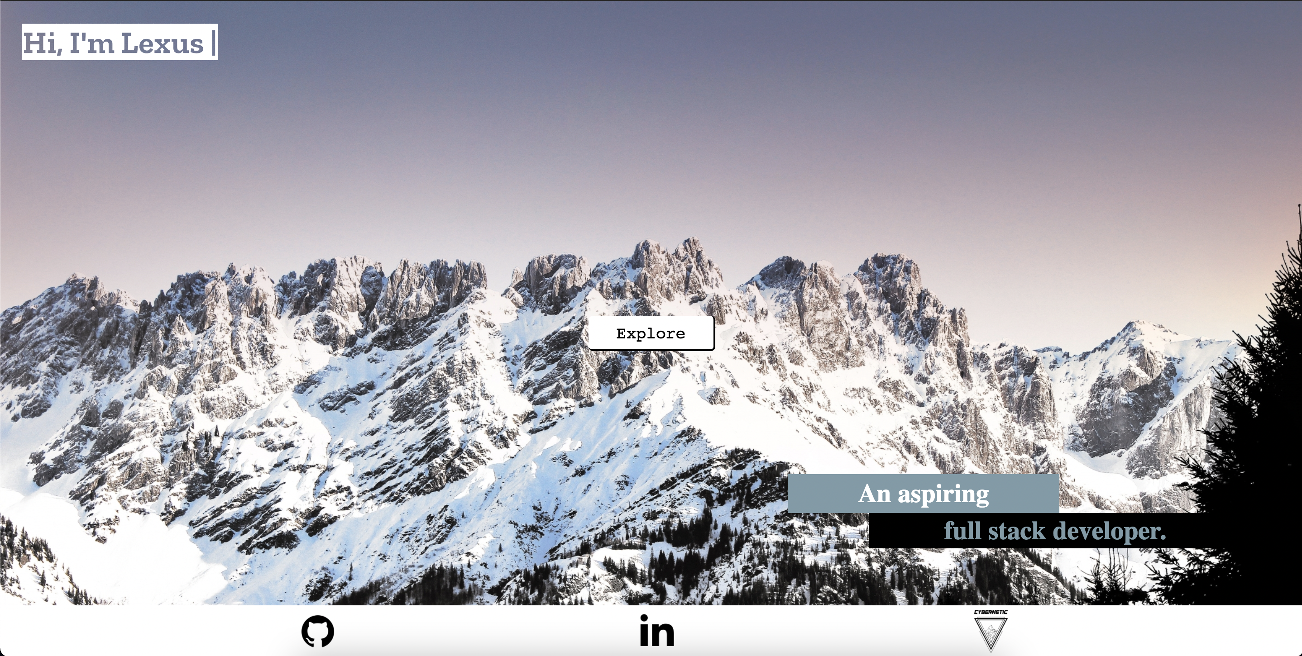

Favourite Parts
Getting the code to work
Learning process

Slide 9
Reflections
Skill level
Growth Mindset
Google is your best friend

